Slide 1
HR DATA ANALYSIS overview of Project HR data analysis project is divided in three section are – 1. In Its first page represent all basic data about company and also called home page of that project. In this 2. The second page is represent the Action page were we have to take some type of action like To terminate some employee and give the promotion to the some employee also 3. Third last page represent the detail page of a employees about his job satisfaction and overtiming and how much employee are working in each department and how many I have to fire them and how many employees I have to give the promotion letter to them.

Slide 2
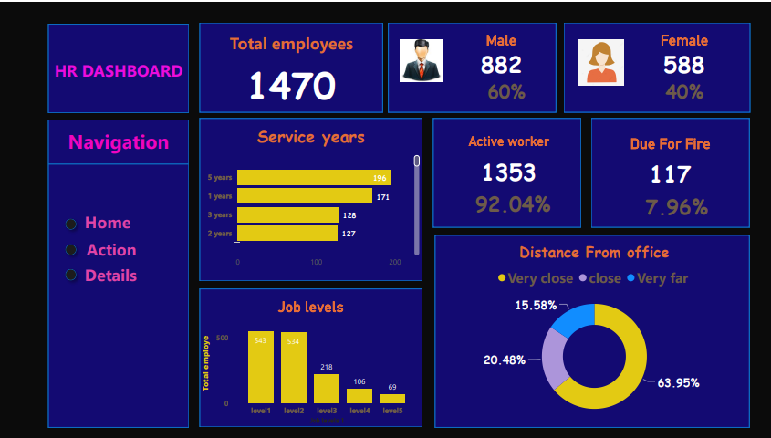

Slide 3
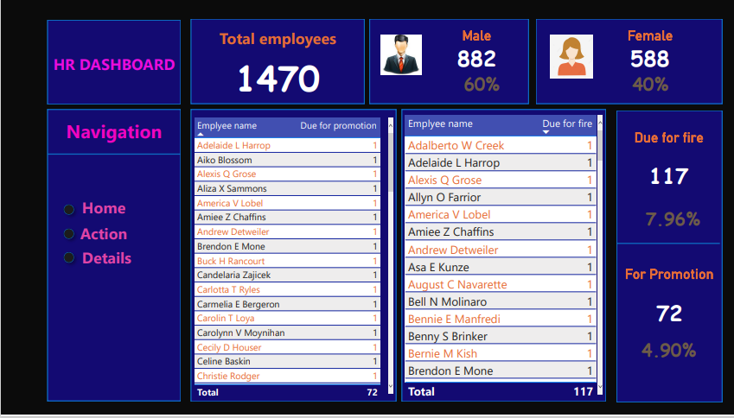

Slide 4
